Slide 1

A
PROJECT PRESENTATION
ON
AUTOMATED FRUIT DETECTION AND SORTING MECHNISM
Presented By
Bansode Dhananjay (B120350803)
Navale Dhiraj (B120350842)
Nevase Rohit (B120350844)
Panval Aniket (B120350846)
Pujari Ratnadeep (B120350854)
Guided By
Dr. P. R.Chitragar
Department of Mechanical Engineering
Vidya Pratishthan’s Kamalnayan Bajaj Institute of Engineering and Technology, Baramati
2017-2018

Slide 2

Contents
Introduction
Literature survey
Objective
Methodology
Experimental Set-up
Image Processing
Applications
References

Slide 3
Introduction
In order to improve the fruits’ quality and production efficiency, to reduce labour intensity, it is necessary to research nondestructive automatic detection technology.
Nowadays, the quality of fruit shape, default, color and size and so on cannot evaluate on line by using traditional methods.
With the development of image processing technology and computer software and hardware, it becomes more attractive to detect fruits’ quality by using vision detecting technology.

Slide 4
Literature Review
Author | Year | Work
J. Ramprabhu and S. Nandhini | 2014 | Have proposed Enhanced technique for sorting and grading the fruit quality using msp 430 controller system
Hongshe Dang, Jinguo Song, Qin Guo | 2010 | Have proposed fruit sizing detecting and grading based on image processing system.
S sun | 2013 | Observed the basis of quality assessment is often subjective with attributes such as apperances,smell,texture and flavour frequently exmined by human inspector.

Slide 5
Objective
To Develop an automated version of fruit processing unit using image processing technique.
Non-destructive type of Testing.

Slide 6
Scope
The other parameters like size, shape, hardness, softness, day light, day temperature, colorization can also be included in this project for future extension.
To avoid occurrence of blind spot, development in mechanism is necessary.

Slide 7
Methodology
1
4
To find problem.
Image Processing Technique.
3
Solution
2
Checking performance of exist system.

Slide 8
5
Testing.
6
Conclusion.

Slide 9
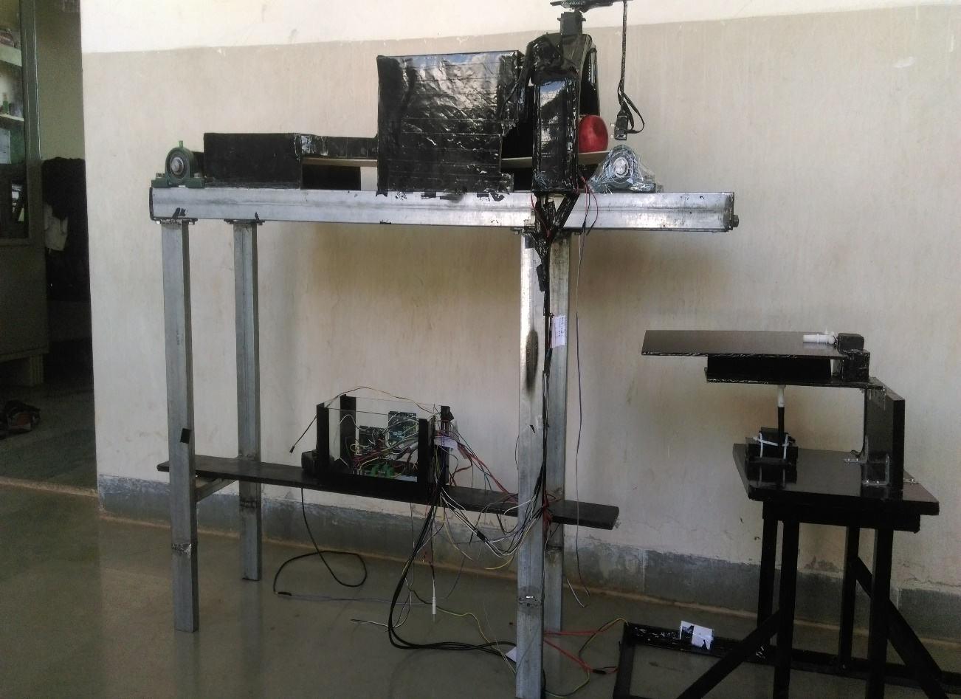
Experimental Set-up
Fruit Detection and Sorting Machine

Slide 10
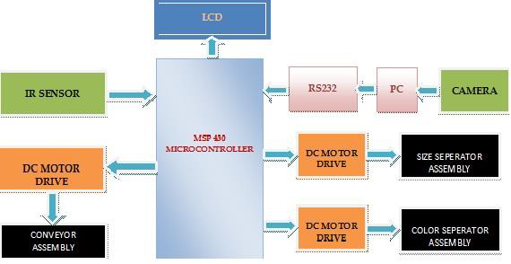
Block Diagram

Slide 11
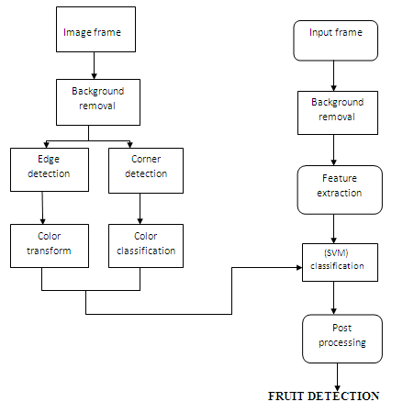
Image Processing
Flow of Process

Slide 12
Applications
Automation in medium scaled food processing industries utilizing the mechatronics sensors.
Segregation of defective fruits from a large lot.
Automatic guidance and delivery of fruit to the food processing unit from the unloading station to the food processor.
Improvised and better control over the quality of output product.

Slide 13
References
[1] | J. Ramprabhu and S.Nandhini “Enhanced Technique for sorting and grading the fruit quality using MSP430 controller” Department of EEE, Kumaraguru College of Technology, Coimbatore, India. Nov (2014) Vol 7,Issue 5(1483-1488)
[2] | Hongshe Dang, Jinguo Song, Qin Guo, “ A Fruit Size Detecting and Grading System Based on Image Processing ” School of Electric and Information Engineering, Shaanxi University of Science and Technology Xi’an City, Shaanxi, 710021 China (2010)
[3] | S Sun et al. “the application of bio atex YG-302 in light weight coated paper” International Journal 2013;56:2183-2198
[4] | V.B. Bhandari, ”Design of Machine Elements”, Third Edition, 2010

Slide 14
THANK YOU

